Slide 1
Course Code: CIT 221 & 222
Course title: Information System Analysis and Design (Theory & Lab.)
By
Golam Md. Muradul Bashir
Professor
Dept. of CCE

Slide 2
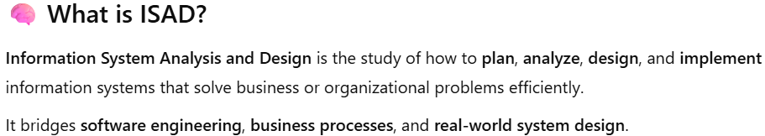
Why Information System Analysis and Design (ISAD) is Important for a CSE Undergraduate

Slide 3
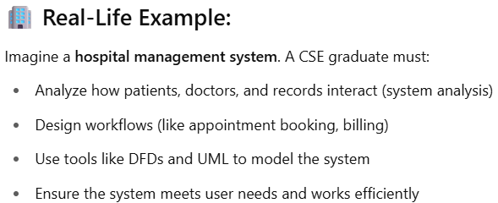
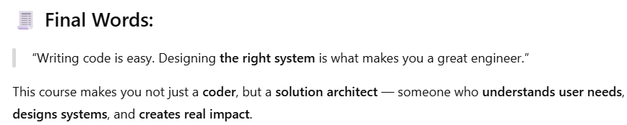
Why Information System Analysis and Design (ISAD) is Important for a CSE Undergraduate

Slide 4
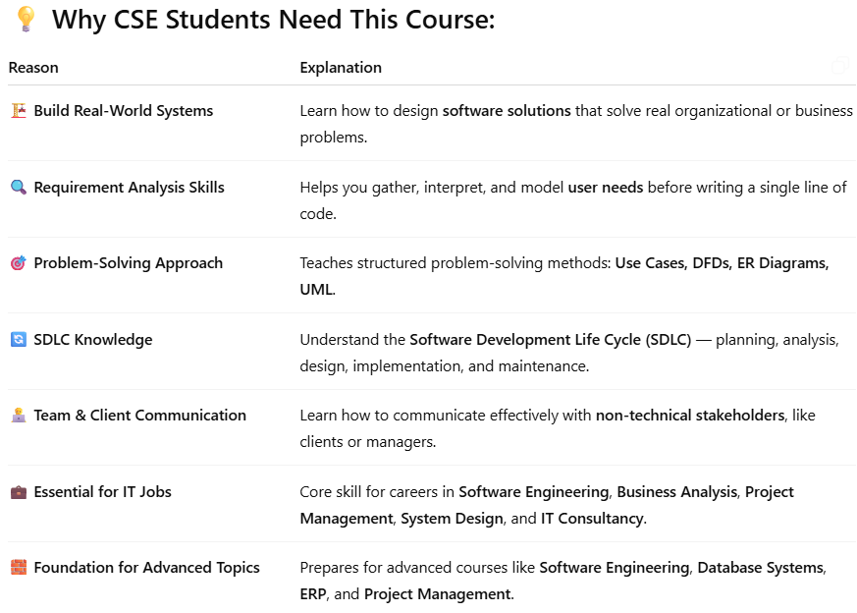

Why Information System Analysis and Design (ISAD) is Important for a CSE Undergraduate
ERP, or Enterprise Resource Planning

Slide 5
System
  From Greek word systema
  Means an organized relationship among functioning units or components

Slide 6
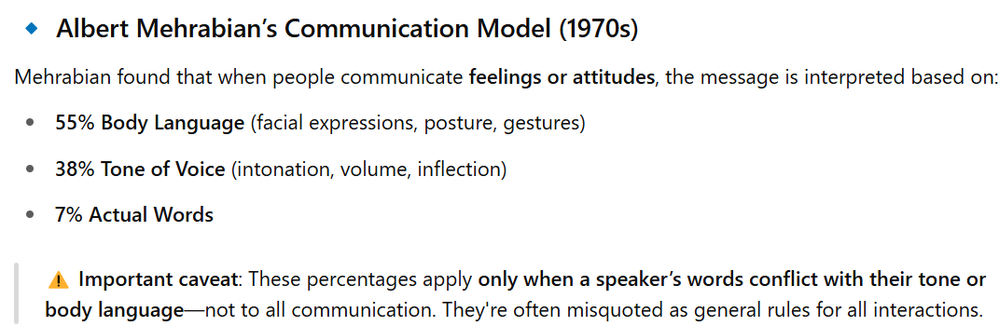
Body Language and Proxemics
Form of nonverbal communication that
We all use & are usually unaware of
If you hear only word you will miss what you want to say
Notes:
Chapter 6 - Requirements Discovery
Teaching Notes
Research studies have determined a startling fact — of a person's total feelings, only 7 percent are communicated verbally (in words), 38 percent are communicated by the tone of voice used, and 55 percent of those feelings are communicated by facial and body expressions.

Slide 7
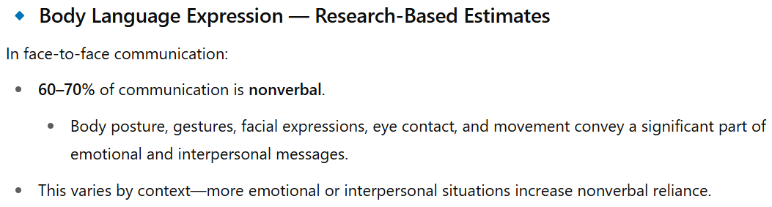
Body Language and Proxemics
Notes:
Chapter 6 - Requirements Discovery
Teaching Notes
Research studies have determined a startling fact — of a person's total feelings, only 7 percent are communicated verbally (in words), 38 percent are communicated by the tone of voice used, and 55 percent of those feelings are communicated by facial and body expressions.

Slide 8
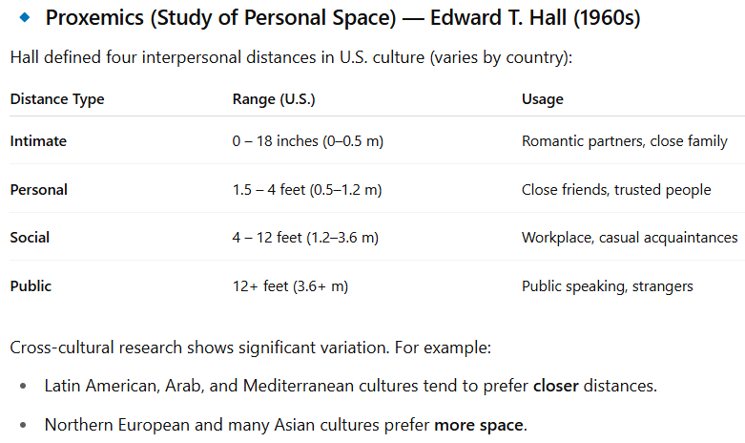
Body Language and Proxemics
Notes:
Chapter 6 - Requirements Discovery
Teaching Notes
Research studies have determined a startling fact — of a person's total feelings, only 7 percent are communicated verbally (in words), 38 percent are communicated by the tone of voice used, and 55 percent of those feelings are communicated by facial and body expressions.

Slide 9
Body Language and Proxemics
Three aspects of Body Language
  Facial disclosure
    One of the most controlled parts of body
  Eye contact
    Direct eye contact can cause strong feelings, either positive or negative
  Posture (attitude)
    Least controlled aspect of the body
    A good analyst wilI watch the audience for changes In posture that could lndicate anxiety, disagreement, or boredom (ekgheyemy)
Notes:
Chapter 6 - Requirements Discovery
Teaching Notes
Research studies have determined a startling fact — of a person's total feelings, only 7 percent are communicated verbally (in words), 38 percent are communicated by the tone of voice used, and 55 percent of those feelings are communicated by facial and body expressions.

Slide 10
Body Language and Proxemics
Body language is all of the nonverbal information being communicated by an individual. Body language is a form of nonverbal communications that we all use and are usually unaware of.
Proxemics is the relationship between people and the space around them. Proxemics is a factor in communications that can be controlled by the knowledgeable analyst.
Notes:
Chapter 6 - Requirements Discovery
Teaching Notes
Research studies have determined a startling fact — of a person's total feelings, only 7 percent are communicated verbally (in words), 38 percent are communicated by the tone of voice used, and 55 percent of those feelings are communicated by facial and body expressions.

Slide 11
C H A P T E R
6
REQUIREMENTSDISCOVERY
Notes:
Chapter 6 - Requirements Discovery
This repository of slides is intended to support the named chapter. The slide repository should be used as follows:
Copy the file to a unique name for your course and unit.
Edit the file by deleting those slides you don’t want to cover, editing other slides as appropriate to your course, and adding slides as desired.
Print the slides to produce transparency masters or print directly to film or present the slides using a computer image projector.
Each slide includes instructor notes. To view those notes in PowerPoint, click left on the View Menu; then click left on Notes View sub-menu. You may need to scroll down to see the instructor notes.
The instructor notes are also available in hard copy as the Instructor Guide to Accompany Systems Analysis and Design Methods, 5/ed.

Slide 12
Introduction to Requirements Discovery
A system requirement (also called a business requirement) is a description of the needs and desires for an information system.
A requirement may describe functions, features (attributes), and constraints.
Notes:
Chapter 6 - Requirements Discovery
No additional notes.

Slide 13
Types of Requirements
A functional requirement is a function or feature that must be included in an information system in order to satisfy the business need and be acceptable to the users.
A nonfunctional requirement is a description of the features, characteristics, and attributes of the system as well as any constraints that may limit the boundaries of the proposed solution.
Notes:
Chapter 6 - Requirements Discovery
Teaching Notes
A functional requirement is an action of the system and usually is written using an action verb phrase. For example:
· The system should process a checking account deposit
· The system should calculate the GPA for a student
· The system should capture the account holder identification information
Examples of nonfunctional requirements.
· be user friendly
· be able to accommodate users at different physical locations
Teaching Tips
Have students give examples of different types of requirements and classify this as functional versus nonfunctional.

Slide 14
Types of Nonfunctional Requirements
Requirement Type
Explanation
Performance
Performance requirements represent the performance the system is required
to exhibit to meet the needs of users.
·
What is the acceptable throughput rate (rate at which a system achieves its goal)?
·
What is the acceptable response time?
Information
Information
n requirements represent the information that is pertinent (relevant)to the
users in terms of content, timeliness, accuracy, and format.
·
What are the necessary inputs and outputs? When must they
happen?
·
What is the required data to be stored?
·
How current must the information be?
·
What are the interfaces to external systems?
Economy requirements represent the need for the system to reduce costs or
Economy
increase profits.
·
What are the areas of the system where costs must be reduced?
·
How much should costs be reduced or profits be increased?
·
What are the budgetary limits?
·
What is the timetable for development?
Control
(and Security)
Control requirements represent the environment in which the system must
operate, as well as the type and degree of security that must be provided.
·
Must access to the system or information be controlled?
·
What are the privacy requirements?
·
Does the criticality of the data necessitate the need for special
handling (backups, offsite storage, etc.) of the data?
Notes:
Chapter 6 - Requirements Discovery
Teaching Tips
Review each category and have the students give additional examples.
Teaching Notes
Other classifications of requirements exist and are published by IEEE and in Military standards. We chose to use PIECES to be consistent and reinforce the theme of the textbook.

Slide 15
Types of Nonfunctional Requirements (concluded)
Requirement Type
Explanation
Efficiency requirements represent the systems ability to produce outputs
Efficiency
with minimal waste.
Are there duplicate steps in the process that must be eliminated?
·
Are there ways to reduce waste in the way the system uses it
resources?
·
Service
Service requirements represent needs in order for the system to be
reliable, flexible, and expandable.
·
Who will use the system and where are they located?
·
Will there be different types of users?
·
What are the appropriate human factors?
·
What training devices and training materials are to be included in
the system?
·
What training devices and training materials are to be developed
and maintained separately from the system, such as stand- alone
computer based training (CBT) programs or databases?
·
What are the reliability/availability requirements?
·
Ho
w should the system be packaged and distributed?
·
What documentation is required?
Notes:
Chapter 6 - Requirements Discovery
No additional notes.

Slide 16
Criteria to Define System Requirements with real example
Defining system requirements is a critical step in system design and development.
It ensures the end product meets the user’s needs and operates effectively within its intended environment.

Slide 17
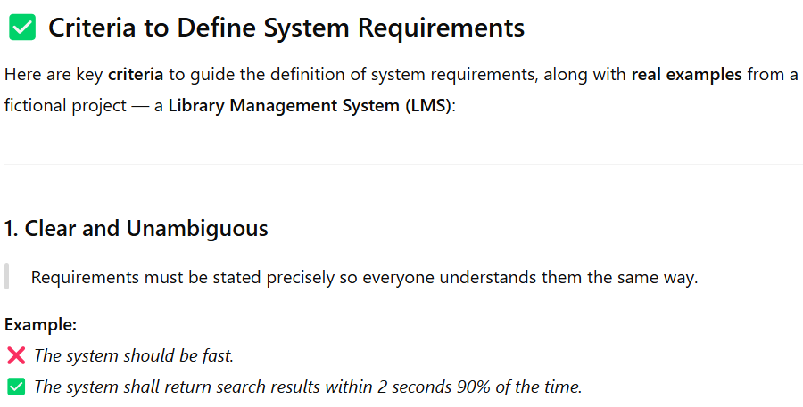
Criteria to Define System Requirements with real example

Slide 18
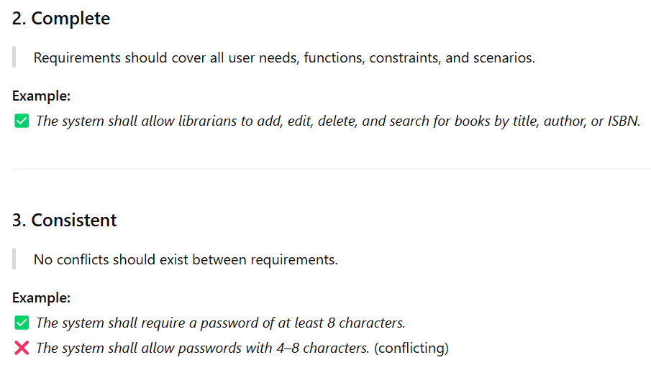
Criteria to Define System Requirements with real example

Slide 19
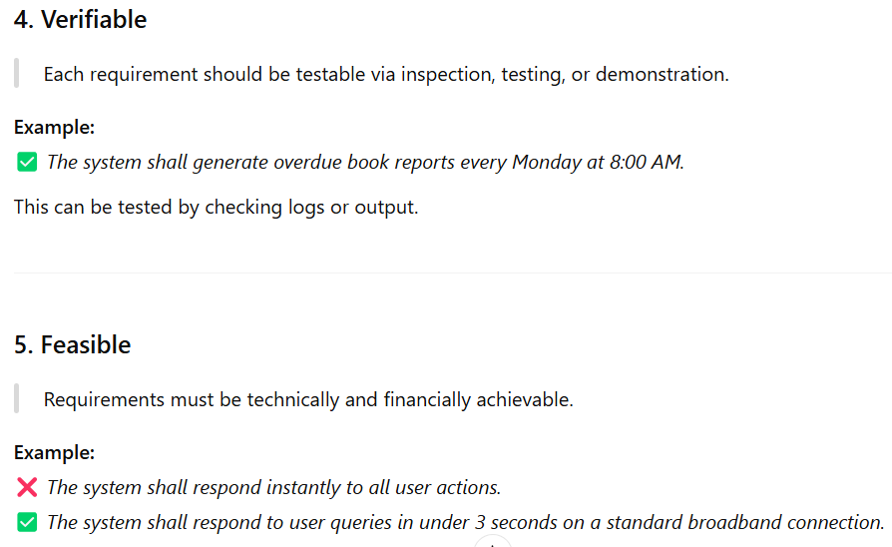
Criteria to Define System Requirements with real example

Slide 20
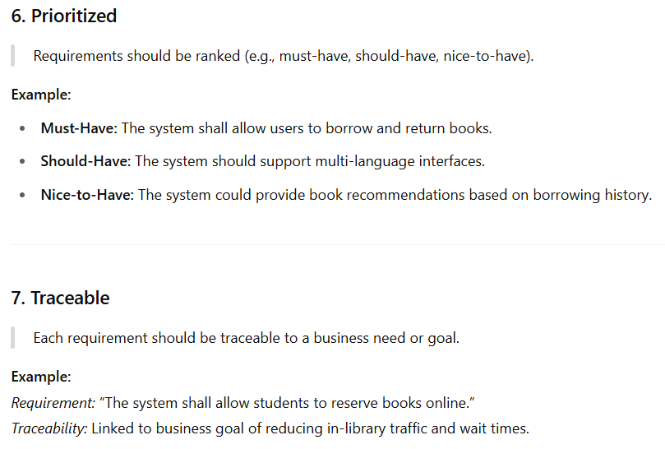
Criteria to Define System Requirements with real example

Slide 21
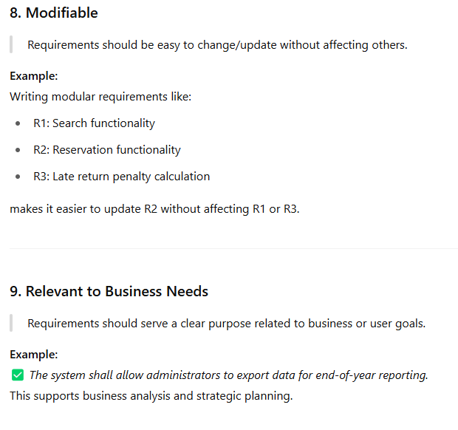
Criteria to Define System Requirements with real example

Slide 22
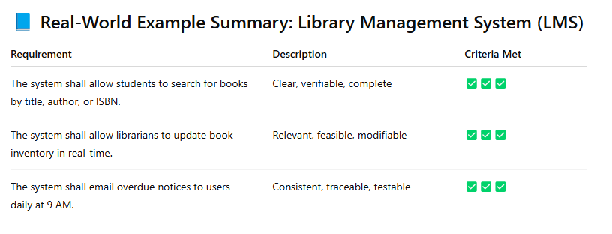
Criteria to Define System Requirements with real example

Slide 23
Criteria to Define System Requirements
Consistent (reliable)
Complete
Feasible
Required
Accurate
Traceable
Verifiable
Notes:
Chapter 6 - Requirements Discovery
Teaching Notes
The goal of the systems analyst is to define system requirements that meet the following criteria:
· Consistent ⎯ the requirements are not conflicting or ambiguous.
· Complete ⎯ the requirements describe all possible system inputs and responses.
· Feasible ⎯ the requirements can be satisfied based on the available resources and constraints (feasibility analysis is covered in Chapter 9).
· Required ⎯ the requirements are truly needed and fulfill the purpose of the system.
· Accurate ⎯ the requirements are stated correctly.
· Traceable ⎯ the requirements directly map to the functions and features of the system.
· Verifiable ⎯ the requirements are defined so they can be demonstrated during testing.

Slide 24
The Process of Requirements Discovery
Problem discovery and analysis
Requirements discovery
Documenting and analyzing requirements
Requirements management
Notes:
Chapter 6 - Requirements Discovery
Teaching notes
The process of requirements discovery consists of four activities.

Slide 25
Requirements Discovery
Fact-finding is the formal process of using research, interviews, questionnaires, sampling, and other techniques to collect information about problems, requirements, and preferences. It is also called information gathering.
Notes:
Chapter 6 - Requirements Discovery
Teaching Notes
Stress that fact-finding is a technique that is used across the entire development cycle but it is extremely critical in the requirements analysis phase.
Teaching Tips
Be sure to discuss the role of ethics during the fact-finding activity.

Slide 26
Seven Fact-Finding Methods
Sampling of existing documentation, forms, and databases.
Research and site visits.
Observation of the work environment.
Questionnaires.
Interviews.
Prototyping.
Joint requirements planning (JRP).
Notes:
Chapter 6 - Requirements Discovery
No additional notes.

Slide 27
Questionnaires
Questionnaires are special-purpose documents that allow the analyst to collect information and opinions from respondents.
  Advantages?
  Disadvantages?
Notes:
Chapter 6 - Requirements Discovery
Teaching Tips
Have students provide advantages and disadvantages of observation.

Slide 28
Questionnaires
Advantages
  Can be answered quickly
  Inexpensive means
  Real facts expressed
  Responses can be tabulated and analyzed quickly

Slide 29
Questionnaires
Disadvantages
  Respondents often low
  No guarantee to get answer or expand all question
  No opportunity for voluntary information
  Not possible to read body language
  Good questions are difficult to prepare

Slide 30
Types of Questionnaires
Free-format questionnaires offer the respondent greater latitude in the answer. A question is asked, and the respondent records the answer in the space provided after the question.
Fixed-format questionnaires contain questions that require selection of predefined responses from individuals.
Notes:
Chapter 6 - Requirements Discovery
Teaching Tips
Have students provide examples of both free-format and fixed-format questions.

Slide 31
Types of Fixed-Format Questions
Multiple-choice questions
Rating questions
Ranking questions
Notes:
Chapter 6 - Requirements Discovery
Teaching Notes
For multiple-choice questions, the respondent is given several answers. The respondent should be told if more than one answer might be selected.
For rating questions, the respondent is given a statement and asked to use supplied responses to state an opinion. To prevent built-in bias, there should be an equal number of positive and negative ratings.
For ranking questions, the respondent is given several possible answers, which are to be ranked in order of preference or experience.

Slide 32
Questionnaire Procedure
Determine what facts and opinions must be collected and from whom you should get them.
Based on the needed facts and opinions, determine whether free- or fixed-format questions will produce the best answers.
Write the questions.
Test the questions on a small sample of respondents.
Duplicate and distribute the questionnaire.
Notes:
Chapter 6 - Requirements Discovery
No additional notes.

Slide 33
Interviews
Interviews are a fact-finding technique whereby the systems analysts collect information from individuals through face-to-face interaction.
  Advantages?
  Disadvantages?
Notes:
Chapter 6 - Requirements Discovery
Teaching Notes
Interviewing can be used to achieve any or all of the following goals: find facts; verify facts; clarify facts; generate enthusiasm; get the end-user involved; identify requirements; and solicit ideas and opinions.
Teaching Tips
Have students provide advantages and disadvantages of interviews.

Slide 34
Advantages
Opportunity to motivate the interviewee
More feedback from the interviewee
Permit system analyst to adapt or reward questions for each individual
possible to read body language

Slide 35
Disadvantages
Disadvantages
  Time consuming
  Success highly depends on system analysts’ human relation skill
  May be impractical due to location

Slide 36
Types of Interviews
Unstructured interviews are conducted with only a general goal or subject in mind and with few, if any, specific questions. The interviewer counts on the interviewee to provide a framework and direct the conversation.
In structured interviews the interviewer has a specific set of questions to ask of the interviewee.
Notes:
Chapter 6 - Requirements Discovery
Teaching Notes
An unstructured interview frequently gets off track, and the analyst must be prepared to redirect the interview back to the main goal or subject. For this reason, unstructured interviews don't usually work well for systems analysis and design.
No additional notes.

Slide 37
Types of Interview Questions
Open-ended questions allow the interviewee to respond in any way that seems appropriate.
Closed-ended questions restrict answers to either specific choices or short, direct responses.
Notes:
Chapter 6 - Requirements Discovery
Teaching Tips
Have students provide examples of open-ended and closed-ended questions.

Slide 38
Procedure to Conduct an Interview
Select Interviewees
Prepare for the Interview
  An interview guide is a checklist of specific questions the interviewer will ask the interviewee.
Conduct the Interview
Follow Up on the Interview
Notes:
Chapter 6 - Requirements Discovery
No additional notes.

Slide 39
Interview Questions
Types of Questions to Avoid
  Loaded questions(do you have to have both of these columns on the report)
  Leading questions(you are agree with it. Are you?)
  Biased questions(how many money for this project. I think 100000)
Interview Question Guidelines
  Use clear and concise(short) language.
  Don’t include your opinion as part of the question.
  Avoid long or complex questions.
  Avoid threatening questions.
  Don’t use “you” when you mean a group of people.
Notes:
Chapter 6 - Requirements Discovery
Teaching Tips
Have students provide examples of loaded, leading, and biased questions.

Slide 40
Sample Interview Guide
Interviewee: Jeff Bentley, Accounts Receivable Manager
Date: Tuesday, March, 23, 2000
Time: 1:30 P.M.
Place: Room 223, Admin. Bldg.
Subject: Current Credit-Checking Policy
Time Interviewer Interviewee
Allocated Question of Objective Response
1 to 2 min. Objective
Open the interview:
    Introduce Ourselves
    Thank Mr. Bentley for his valuable time
    State the purpose of the interview--to obtain an
    understanding of the existing credit-checking policies
5 min. Question 1
What conditions determine whether a customer’s order is
approvedfor credit?
Follow-up
5 min. Question 2
What are the possible decisions or actions that might be
taken once these conditions have been evaluated?
Follow-up
3 min. Question 3
How are customers notified when credit is not approved
for their order?
Follow-up
(continued)
Notes:
Chapter 6 - Requirements Discovery
No additional notes.

Slide 41
Sample Interview Guide (concluded)
1 min. Question 4
After a new order is approved for credit and placed in the
file containing orders that can be filled, a customer might
request that a modification be made to the order. Would
the order have to go through credit approval again if the
new total order cost exceeds the original cost?
Follow-up
1 min. Question 5
Who are the individuals that perform the credit checks?
Follow-up
1 to 3 mins. Question 6
May I have permission to talk to those individuals to learn
specifically how they carry out the credit-checking process?
Follow-up
1 min. Objective
Conclude the interview:
    Thank Mr. Bentley for his cooperation and assure him
    that he will be receiving a copy of what transpired during
    the interview
21 minutes Time allotted for base questions and objectives.
9 minutes Time allotted for follow-up questions and redirection
30 minutes Total time allotted for interview (1:30 p.m. to 2:00 p.m.)
General Comments and Notes:
Notes:
Chapter 6 - Requirements Discovery
No additional notes.

Slide 42

Interviewing Do’s and Don’ts
Do
Be courteous (polite)
Listen carefully
Maintain control
Probe (inquery)
Observe mannerisms and nonverbal communication
Be patient
Keep interviewee at ease
Maintain self-control
Avoid
Continuing an interview unnecessarily.
Assuming an answer is finished or leading nowhere.
Revealing (express) verbal and nonverbal clues.
Revealing your personal biases.
Talking instead of listening.
Assuming anything about the topic and the interviewee.
Tape recording -- a sign of poor listening skills.
Notes:
Chapter 6 - Requirements Discovery
Teaching Tips
Discuss with the students each of the items and the reasons for their classifications.

Slide 43
Communicating With the User
Listening - “To hear is to recognize that someone is speaking, to listen is to understand what the speaker wants to communicate.” (Gildersleeve – 1978)
Guidelines for Communicating
  Approach the Session with a Positive Attitude
  Set the Other Person at Ease
  Let Them Know You Are Listening
  Ask Questions
  Don’t Assume Anything
  Take Notes
Notes:
Chapter 6 - Requirements Discovery
Teaching Tips
Ask the students to comment on hearing versus listening. Ask them to give you examples.
Focus on the story by Art Linkletter and why not assuming anything is important.

Slide 44
Brainstorming
Brainstorming is a technique for generating ideas during group meetings. Participants are encouraged to generate as many ideas as possible in a short period of time without any analysis until all the ideas have been exhausted.
Notes:
Chapter 6 - Requirements Discovery
Teaching Notes
Sometimes, one of the goals of a JRP session is to generate possible ideas to solve a problem. Brainstorming is a common approach that is used for this purpose.

Slide 45
Brainstorming Guidelines
Isolate the appropriate people in a place that will be free from distractions (diversion) and interruptions
Make sure that everyone understands the purpose of the meeting
Appoint one person to record ideas
Remind everyone of the brainstorming rules
Within a specified time period, team members call out their ideas as quickly as they can think of them
After the group has run out of ideas and all ideas have been recorded, then and only then should the ideas be analyzed and evaluated
Refine, combine, and improve the ideas that were generated earlier
Notes:
Chapter 6 - Requirements Discovery
Teaching Tips
Be sure to discuss the rules of brainstorming:
Be spontaneous. Call out ideas as fast as they occur.
Absolutely no criticism, analysis, or evaluation of any kind is permitted while the ideas are being generated. Any idea may be useful, if only to spark another idea.
Emphasize quantity of ideas, not necessarily quality.

